Slide 1
Meta Learning
Natural Language Processing

Slide 2
Suggested Readings
Meta-learning for Few-shot Natural Language Processing: A Survey (simple survey to start with)
Model-Agnostic Meta-Learning for Fast Adaptation of Deep Networks (original paper of MAML, cited almost 5000 times)
Learning to Few-Shot Learn Across Diverse Natural Language Classification Tasks (LEOPARD, a very good paper to start reading)
Making Pre-trained Language Models Better Few-shot Learners
It’s Not Just Size That Matters: Small Language Models Are Also Few-Shot Learners
All few shot learning papers in NLP (all the necessary papers to read)
CS330: Deep Multi-Task and Meta Learning (very good stanford courses)

Slide 3
Meta Learning
Meta Learning is a family of methodologies that aims to predict new task with only few examples (i.e., to learn extremely quickly)
Meta Learning is one of the most successful methodologies for solving the few-shot learning problem

Slide 4
Clarifications
Few shot learning is a problem area, i.e., able to predict using only few examples, but meta learning is one methodology (you can see that pre-trained model or multi-task model can also do few-shot)
Transfer Learning is also problem area; Meta learning can also be a methodology
Transfer learning is about using past experience of source task to improve learning on a target task
Methodologies:
Pretrained model and finetuning
Multi-task learning is another way but it is more about making one unified model
Meta learning is another way but it is more about training using few examples
Multitask Learning is also a methodology, in which you train all datasets at the same time, but Meta Learning train many tasks with very few examples sequentially.

Slide 5
Meta Learning

Slide 6
Definition: K-shot N-way learning
K-shot N-way learning refers to learning only K examples per N class, and try to predict a large set of unlabeled test examples, e.g., 1-shot 3-way learning
ONE TRAINING TASK
Training (support set) | Class
I love dog. | Positive
I dislike movie. | Negative
I play soccer. | Neutral
Testing (query set) | Class
Chaky eat ice-cream. | ?

Slide 7
Definition: K-shot N-way learning
This is called one training task (support + query set)
In few shot learning, we have many training tasks, where these tasks can differ in class, or even domains
But all training tasks have the same structure, i.e., K examples per N classes
There are two definitions of training “tasks” in NLP
Class is a task
Domain is a task
Note that it is very important to keep the order of samples in the support set randomized; otherwise, the model will remember the order, not the real data.
Training Task 1
Training Task 2
….
Training Task T
Testing Task T

Slide 8
Datasets for few-shot NLP
Class as task
FewRel - a relation classification datasets
SNIPS - an intent classification dataset with only seven intent types
Domain as task
CLINC50 - an intent classification dataset with 150 intents and 15 domains
ARSC - a sentiment classification dataset with 23 products and 3 ratings, thus 69 tasks
Note: In CV, search “Omniglot” (characters), “CUB” (bird), “miniImageNet”

Slide 9
Meta Learning Approaches
There are just so many, but for starters ( a lot of this is mostly cited 2000+ except for the very recent one):
Metric-Based
Siamese Network (2005)
Matching Network (2016)
Prototypical Network (2017)
Relation Network (2018)
Optimization-Based
MAML (2017)
iMAML (2019)
Note: there are also Bayesian methods and GANs methods

Slide 10
Meta Learning Approaches

Slide 11
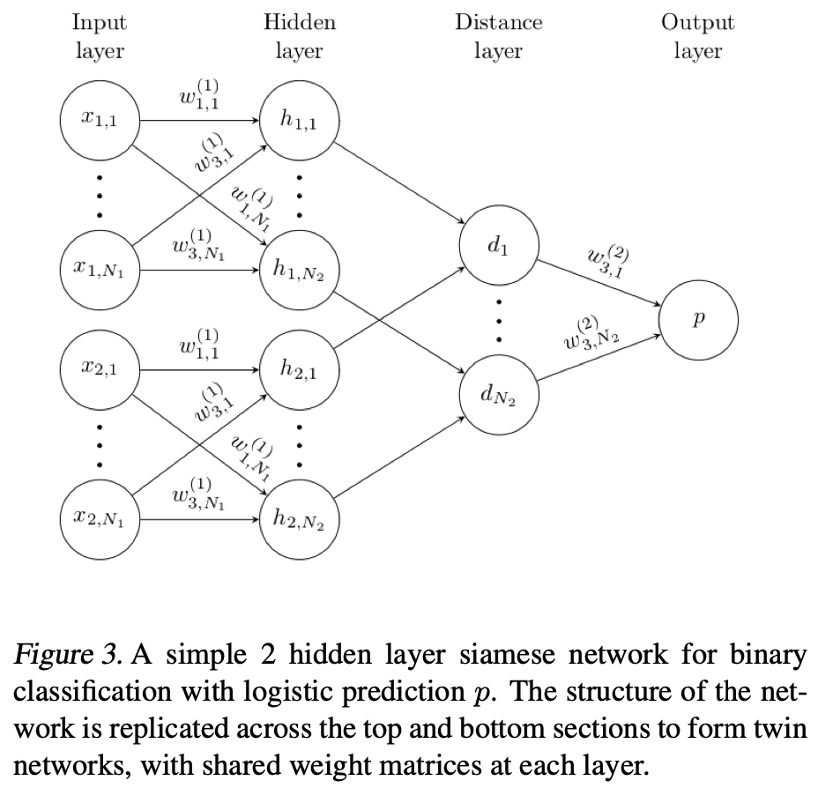
Metric-based: Siamese Network
Learns a distance metric
By comparing between support and query set, it produces a distance score that is used to estimate the class membership
Note that the network that creates the representation for support and query set is shared (basically same network, even the picture looks like two separate)
But support only two classes
Very classic, and all metric based models are based on this….anyhow, you should not use this
Good to start playing with, if you are interested….
Siamese Neural Networks for One-Shot Image Recognition, Koch et al. (2005), https://www.cs.cmu.edu/~rsalakhu/papers/oneshot1.pdf

Slide 12
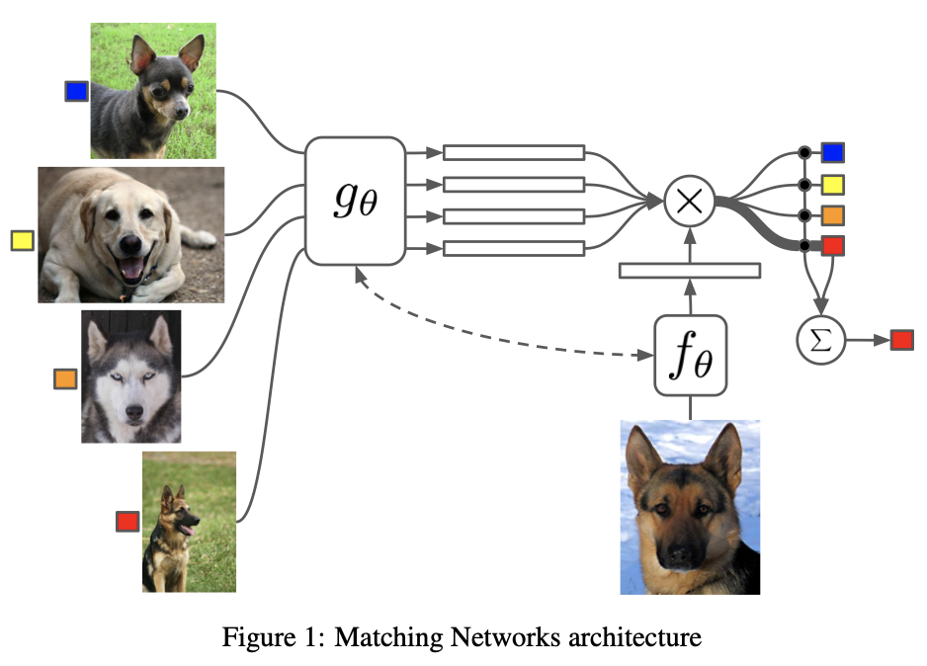
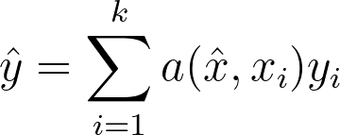

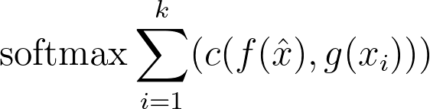
Metric-based: Matching Network
Learns to match query set items to support set items
The support set is considered as a sequence, and the query is embedded in it via a bidirectional LSTM
The model in its simplest form:
where and are samples and labels from the support set, and and are the query sample and label.
Here is calculated as
is a biLSTM with all the support set samples concatenated with CNN features, and is CNN
Matching Networks for One Shot Learning, Vinyals et al. (2016), https://arxiv.org/abs/1606.04080

Slide 13
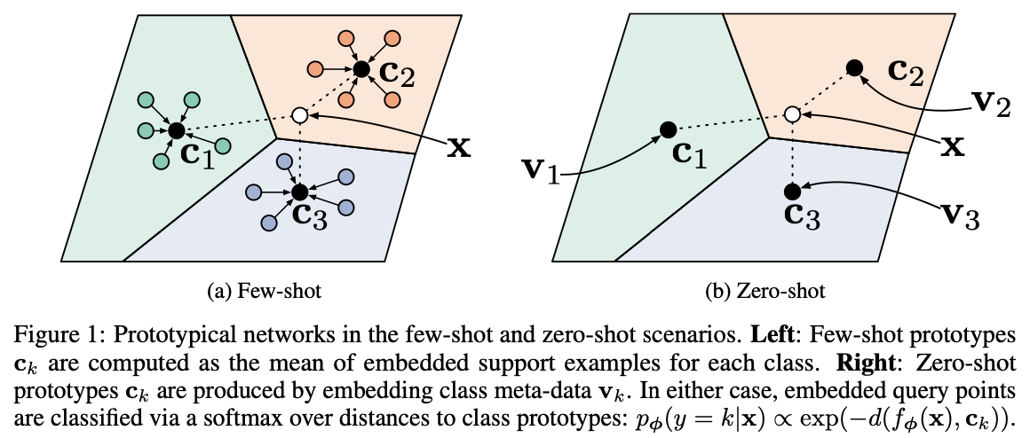
Metric-based: Prototypical Network
First, it estimates class mean vectors (prototypes) over the support set.
Then it measure the distance between a query vector and the prototypes. The query belongs to the closest prototype.
Found that euclidean distance is better than cosine similarity
Note that the figure is a 3-way 5-shot learning
Prototypical Networks for Few-Shot Learning, Snell et al. (2017), https://arxiv.org/abs/1703.05175

Slide 14
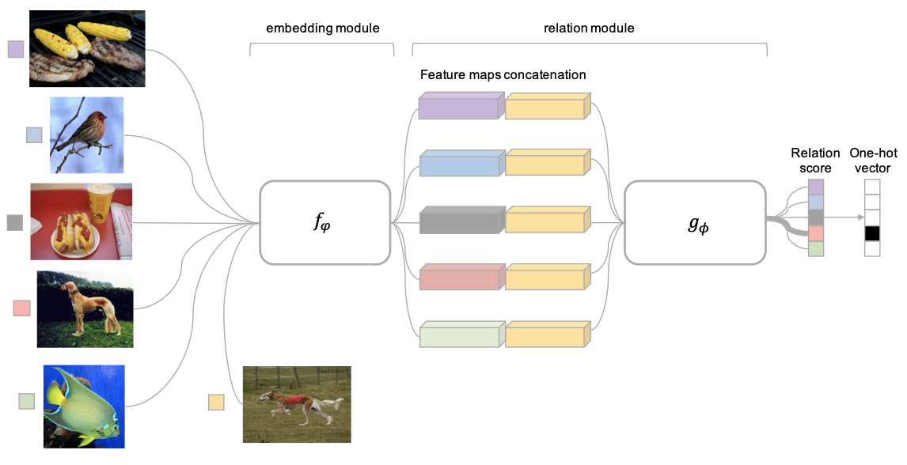
Metric-based: Relation Network
A relation module is used to compare the embeddings of the support set with the embeddings of the query set.
A relation score (between 0 and 1) represents the similarity between query and support samples
Difference between relation network and prototypical network is that the scoring function is a network, not Euclidean distance
Note that the example is a 5-way 1 shot problem
Learning to Compare: Relation Networks for Few-Shot Learning, Sung et al. (2018), https://arxiv.org/abs/1711.06025

Slide 15
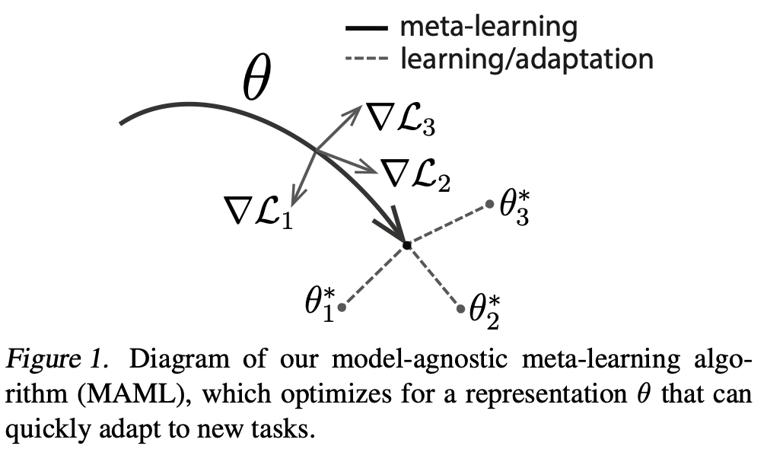

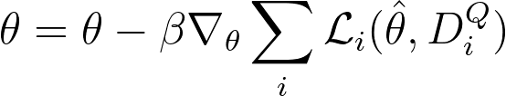
Optimization-based: MAML
Model agnostic method
Can be used for classification, regression, RL
Find a set of weights that can quickly adapt to new tasks
Idea: Use the validation loss to update the parameter
First step (support set):
Second step (query set):
Limitation: computationally expensive
Model-Agnostic Meta-Learning for Fast Adaptation of Deep Networks, Finn et al. (2017), https://arxiv.org/abs/1703.03400 How to train your MAML, Antoniou et al. (2019), https://arxiv.org/pdf/1810.09502.pdf

Slide 16
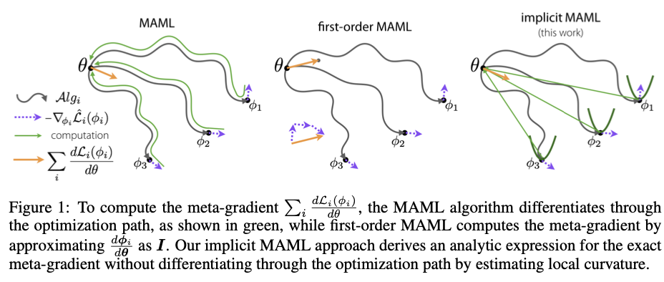
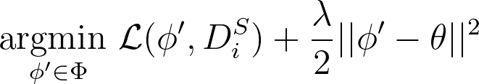
Optimization-based: iMAML
To avoid the computationally expensive procedure, several papers have been proposed.
In first-order MAML, instead of backpropagating all the way, just estimate the gradient using the gradients for each task (does not work well though)
In iMAML (implicit gradients MAML), the idea is to maintain a close dependence between task parameters and the generic parameters
Meta-Learning with Implicit Gradients, Rajeswaran et al. (2019), https://arxiv.org/abs/1703.03400

Slide 17
Summary
Meta learning is a promising approach to achieve few shot learning
Two categories: metric based and optimization based
Metric-Based
Simple, but only based on similarity, i.e., between two classes
Optimization-Based
Effective; can also work for regression/RL; but derivatives in n-order is computationally expensive
New papers are coming up to solve this computational problem
There are many papers I didn’t cover….e.g., Reptile, Bayesian MAML, Meta-SGD, LEOPARD
Many rooms to work on meta learning for NLP :-)

Slide 18
So what topic is good for thesis/RS?
Multi-Task / Meta Learning / Pre-training + Fine tuning for transfer/few-shot learning
Cross modal learning - text to images, text to drawing icons/graffiti, text to cooking recipes, etc.
Analytical Work, e.g., understanding
Understanding robustness to domain shift or adversarial attacks or text modifications
Understanding gender bias, trustworthiness
Understanding evaluation metrics (proposing some simpler metrics, or understand)
Practical applications - using summarization to summarize papers, using dialogue/question-answering for medical checkups, a Thai grammar checker/writer, etc.

Slide 19
Last note
Thank you for fighting through! It’s hard but it’s worth it, right? :-)
Barely scratch the surface, but hopefully we prepare you for success
Good luck for your future career

